Slide 1
Supporting Homeless Children and Youth in Everett Public Schools
Kids in Transition
Cynthia Jones,
Homeless Liaison
Amy Perusse,
Homeless Facilitator
Notes:
This presentation will provide information for you about the EPS program to support homeless children and youth, which we call our Kids in Transition or KIT program.

Slide 2

Today’s goals
Share data about homeless students in EPS
Briefly share basic concepts of the McKinney-Vento Act
  Eligibility
  School selection
  Immediate enrollment
  Transportation
Provide suggestions about what you can do to support homeless students
Notes:
In this presentation we will share data about homeless students in EPS, explain basic concepts about the federal McKinney-Vento Act, and provide suggestions about what you can do to support homeless students.

Slide 3

Turn and talk
Who or what do you think of when you think of homeless students in Everett Public Schools?
How many homeless students do you think were enrolled in EPS last year?
Notes:
First, take 30 seconds to talk to a neighbor. Who or what do you think of when you think of homeless students in EPS? And – how many homeless students do you think were enrolled in EPS last year?

Slide 4
How many identified
EPS kids in transition?
1101 students qualified at some time last year.
In September 2015 there were 493 identified eligible active students. In 2016 we had 525 identified active students as of September 22.
Notes:
During 2015 – 16 school year, 1101 students qualified as homeless. This year we had about 30 more students in September than we did the year before.

Slide 5
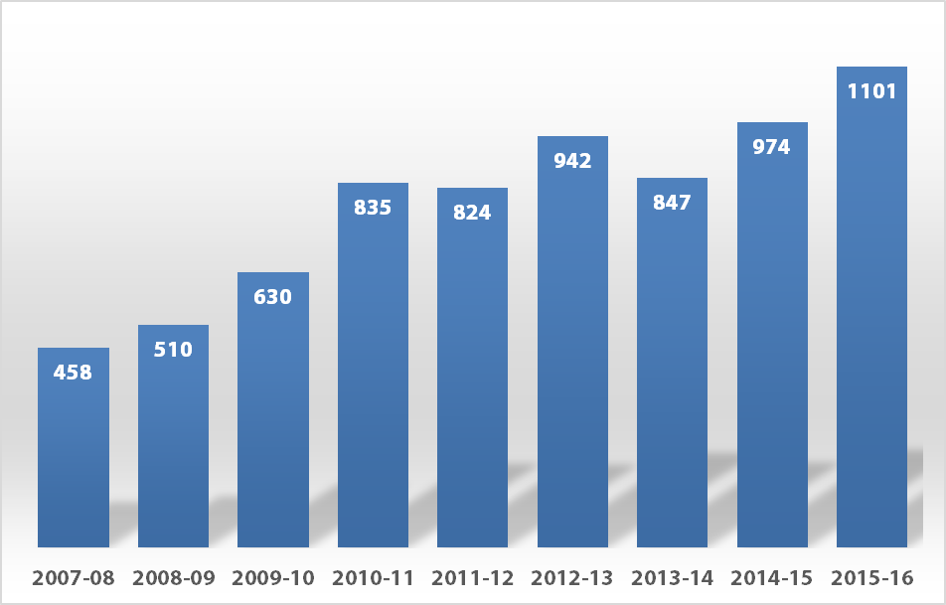
Growth in number of homeless students in EPS 2008-2016
Notes:
In fact, our numbers have grown steadily over the past 9 years, as you can see in this slide.

Slide 6
How many in my school?
Number KIT Students in EPS by School
SCHOOL | Oct. 10, 2016 | 2015-16 cumulative |  | SCHOOL | Oct. 10, 2016 | 2015-16 cumulative
Cedar Wood | 4 | 10 |  | Eisenhower | 14 | 26
Emerson | 22 | 37 |  | Evergreen | 45 | 59
Forest View | 6 | 5 |  | Gateway | 2 | 4
Garfield | 42 | 51 |  | Heatherwood | 12 | 19
Hawthorne | 31 | 91 |  | North | 39 | 93
Jackson ES | 10 | 36
Jefferson | 13 | 17 |  | Cascade High | 35 | 78
Lowell | 37 | 84 |  | Everett High | 85 | 152
Madison | 28 | 44 |  | Jackson High | 25 | 47
Mill Creek | 3 | 13 |  | Sequoia High | 30 | 77
J. Monroe | 10 | 20
Penny Creek | 7 | 16 |  | Other | 9 | 25
Silver Firs | 9 | 15
Silver Lake | 16 | 22
View Ridge | 13 | 28
Whittier | 11 | 24
Woodside | 5 | 8 |  | TOTAL | 563 | 1101
Notes:
You are probably wondering how many KIT students are in your school. This table shows the number at each school in two ways. First, the number of KIT students who have enrolled and attended up to October 10, 2016, and second, the total cumulative number of KIT students who attended the school at any time during the 2015-16 school year.

Slide 7

The McKinney-Vento Act
Title X, Part C of No Child Left Behind 2001
Main themes of the McKinney-Vento Act:
  School stability
  School access
  Support for academic success
  Child-centered, best interest decision making
Notes:
The McKinney-Vento Act is part of No Child Left Behind.
It provides support for homeless children in four ways: through ensuring school stability and school access, providing additional support for academic success, and by always keeping the interest of the student in the center.

Slide 8
Why the McKinney-Vento Act?
In Washington State: The four-year graduation rate for homeless students in the Class of 2015 was 51.9 percent; for all students, it was 78.1 percent
Research shows:
  It takes 4 – 6 months for a student to recover academically from a change of schools
  Lower attendance rates; lower achievement; increased sense of alienation > increased risk of dropping out
  Relationships with consistent adults matter
Provide stability and sense of security in an uncertain time in a child’s life
Notes:
The McKinney-Vento Act is a response to data that shows it takes students a significant amount of time to recover academically from a change in schools, that students who move from school to school typically have lower attendance rates which leads to lower achievement. We know that relationships with consistent adults matter, and so McKinney-Vento is intended to provide stability in an uncertain time in a child’s life.

Slide 9

Who qualifies for services?
Children or youth who lack a fixed, regular, and adequate nighttime residence
Fixed:
  Stationary, permanent, and not subject to change
Regular:
  Used on a predictable, routine, or consistent basis (e.g. nightly)
Adequate:
  Sufficient for meeting both the physical and psychological needs typically met in home environments
Notes:
To determine who qualifies we look at the student’s night-time residence. That residence needs to meet a three-part test. Is the residence fixed, regular, and adequate?

Slide 10
Who qualifies for services?
Children or youth who lack a fixed, regular, and adequate nighttime residence, including:
Sharing the housing of others due to loss of housing, economic hardship, or similar reason (“doubled up”)
    Why did the family move in together? Due to a crisis or by mutual choice as a plan for mutual benefit?
    How permanent is the living arrangement intended to be?
    Is the living arrangement fixed, regular, and adequate?
Notes:
Children who are sharing the housing of others due to loss of housing or a crisis qualify – we call them ‘doubled up’.

Slide 11
Who qualifies for services?
Children or youth who lack a fixed, regular, and adequate nighttime residence, including:
Sharing the housing of others due to loss of housing, economic hardship, or similar reason (“doubled up”)
Living in motels, hotels, trailer parks, or camp grounds due to the lack of adequate alternative accommodations
Notes:
Students who are living in motels or campgrounds due to lack of adequate alternatives qualify.

Slide 12
Who qualifies for services?
Children or youth who lack a fixed, regular, and adequate nighttime residence, including:
Sharing the housing of others due to loss of housing, economic hardship, or similar reason (“doubled up”)
Living in motels, hotels, trailer parks, or camp grounds due to the lack of adequate alternative accommodations
Living in emergency or transitional shelters
Notes:
Children who are living in shelters qualify.

Slide 13
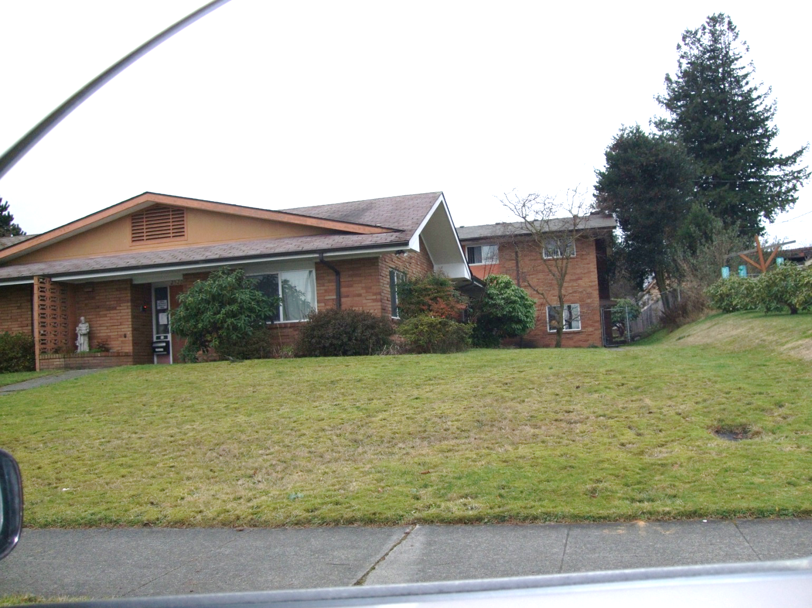
Interfaith Family Shelter
Notes:
We are fortunate to have several shelters in Everett, including Interfaith

Slide 14
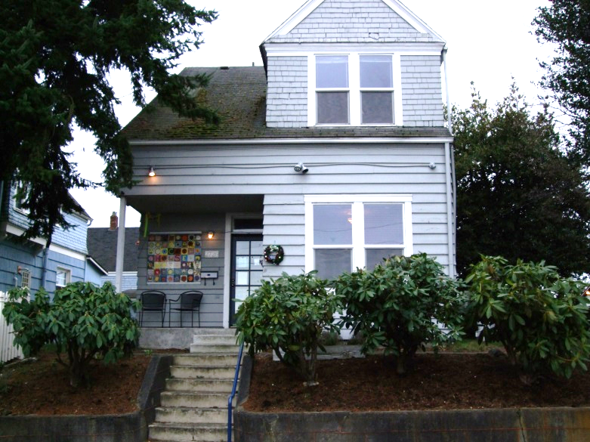
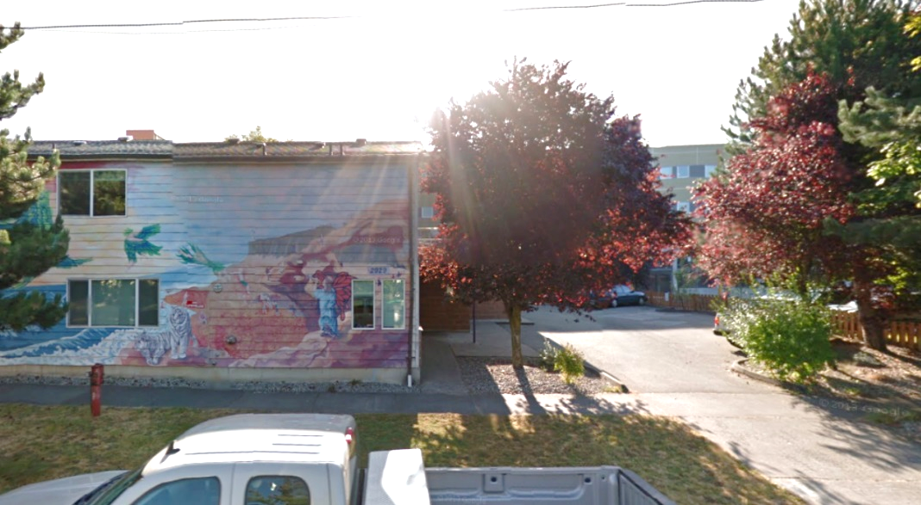
Cocoon House Youth Shelters
Arlington: Home for pregnant or parenting teen mothers and their children
Everett: Two sites offering short term and long term housing
Monroe: Home with temporary housing
Notes:
And Cocoon House.

Slide 15
Who qualifies for services?
Children or youth who lack a fixed, regular, and adequate nighttime residence, including:
Sharing the housing of others due to loss of housing, economic hardship, or similar reason (“doubled up”)
Living in motels, hotels, trailer parks, or camp grounds due to the lack of adequate alternative accommodations
Living in emergency or transitional shelters
  Awaiting foster care placement
  Living in cars, parks, abandoned buildings, substandard housing, bus or train stations, or a similar setting
Notes:
And children who are living in cars, parks, abandoned buildings, substandard housing, or similar settings qualify.

Slide 16
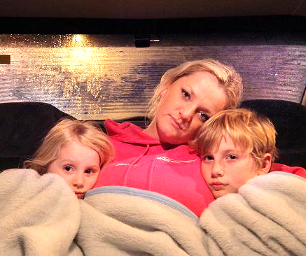
Living in cars . . .
The typical wait for emergency shelter for families is 6-8 weeks.
Notes:
While we are lucky to have shelters in our community, they are not easy to get into. Families sometimes have to split up because shelters only take residents of certain ages and genders.

Slide 17

Case-by-case
Determinations of eligibility are made on a case-by-case basis by examining the living arrangement of each child or youth.
Determinations are made in the Categorical Programs office, based on school recommendation and information.
We receive guidance and training through OSPI.
Notes:
Determinations of eligibility are made on a case-by-case basis by examing the living arrangement of each child.

Slide 18

School selection: two options
Students experiencing homelessness have the right to attend one of two schools:
  Local attendance area school
    Any public school that students living in the same attendance area are eligible to attend
  School of origin
    The school attended when permanently
    housed; or
    The school in which the student was last
    enrolled
Notes:
Students who qualify for KIT support have the right to attend one of two schools:
The school that other students living in the same area normally attend,
Or the school the student last attended, called the school of origin.

Slide 19

Best interest
When deciding which school the student will attend, the best interest of the student is the top priority
Best interest:
  Usually, to keep homeless students in their schools of origin, to the extent feasible, unless this is against the parent’s or guardian’s wishes
Notes:
When deciding which school the student will attend, the best interest of the student is the top priority. Usually, that is to maintain stability in the school of origin.

Slide 20
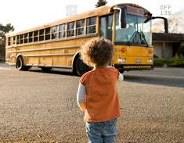
Feasibility
Feasibility factors:
  The age of the student
  The distance of the commute
  Personal safety issues
  A student's need for a special program
  The length of anticipated stay in a
  temporary location
  The time remaining in the school year
  Connection to the school
Notes:
However, we consider whether the school of origin is feasible. Feasibility depends upon the age of the child and a number of other factors as listed here.

Slide 21

Immediate enrollment
Homeless children and youth have the right to enroll in school immediately, even if lacking documentation normally required for enrollment.
If a student does not have immunizations or medical records, the liaison must assist in obtaining them, and the student must be enrolled in the interim.
They automatically qualify for free meals.
Notes:
Students who qualify for KIT must be enrolled immediately, even if they don’t have all the necessary records and paperwork. They automatically qualify for free meals.

Slide 22

Transportation
Districts must transport homeless students to and from the school of origin, at a parent’s or guardian’s request.
Notes:
Districts are required to provide transportation for students to and from their school of origin.

Slide 23
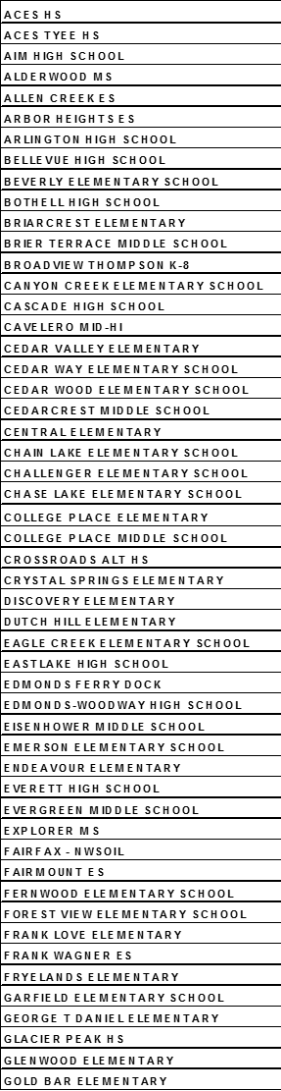
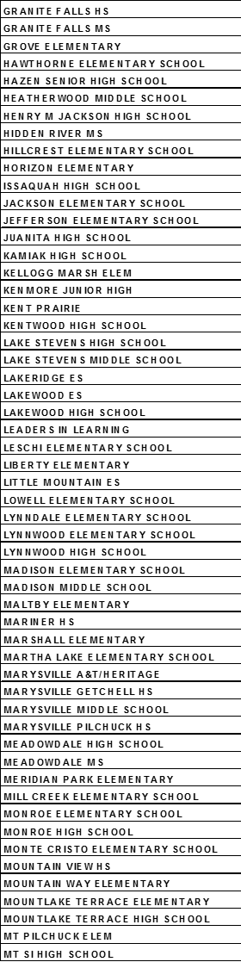
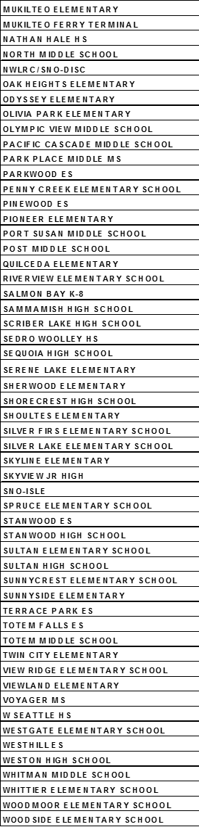
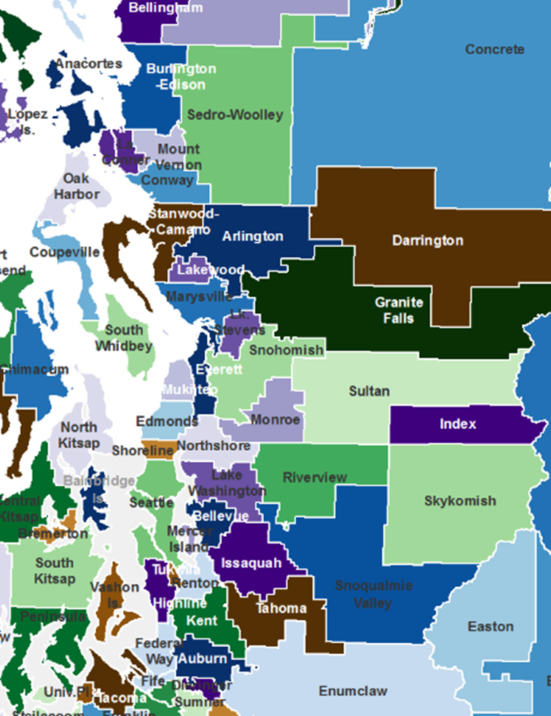
162 different schools in 28 districts
Notes:
Last year, we transported students to 162 different schools in 28 districts.

Slide 24

Additional support
  In some circumstances and “after exhausting all other available resources”:
Tutoring
School uniforms
Fees
Transportation to participate in after school activities (extended day, extra curricular activities)
Clothing, shoes, school supplies
Contact Amy for specific support
Last year, 21 high school KIT students accessed classes and activities such as Running Start, Sno-Isle, Advanced Placement, and DECA with support from our KIT program.
Notes:
KIT students can also receive additional support for academic success and to enable them to participate fully in the life of the school through extra-curricular activities.

Slide 25

How can I support our KIT kids?
Teach to the ceiling; support from the floor
  They need to be held to the same standards
  They need differentiated support
  Support looks different for each student
Be sensitive to their situation and respect their privacy
Notes:
What can you do to support your KIT students?
KIT students needs to be held to the same standards as other kids, but they may need more support – and different kinds of support – to get there. Be respectful of their situation.

Slide 26
How can I support our KIT KIT kids?
Be aware of signs of homelessness
  Wearing the same clothes
  Lack of personal hygiene
  Arriving tardy
  Difficulty completing homework assignments
You may hear comments like
  “We are moving around a lot right now.”
  “I am staying with a friend.”
  We just moved and I don’t know my address.”
If you think a student may qualify, let us know so we can determine eligibility and provide support
  Information comes up in IEP meetings, BECCA meetings, conversations with parents, etc.
Notes:
Be watchful for signs that a student might be homeless.
If you think a student might qualify, talk to your building point person or counselor.

Slide 27
What can I do to help?
Volunteer at a shelter or social service agency
Be a mentor at a school
Donate to an organization that supports the homeless
  SchoolBell, Clothes for Kids, Volunteers of America, United Way, Everett Public Schools Foundation Stuff the Bus for Kids campaign, shelters
Advocate for living wage jobs, low income housing, and support for social services
Notes:
There are many ways to get involved to support homeless students and families.

Slide 28

Who do I talk to for more information?
For more information, questions, or if you think a student might be eligible for KIT support, talk to:
1) Your building contact
2) Amy Perusse, KIT Facilitator, ext. 4032
Notes:
For more information, questions, or if you think a student might be eligible for KIT services, talk first to your building contact for KIT. Amy Perusse, KIT Facilitator is also available to help answer questions.

Slide 29
Turn and talk
Where does your job overlap with McKinney-Vento?
What’s your circle of influence?
Notes:
Take a minute to reflect with your neighbor – where does your job overlap with McKinney-Vento? What’s your circle of influence?

Slide 30
Thank you for your support of our KIT students.
Notes:
Thank you for your support of our KIT students.

